Slide 1

DEPARTMENT OF ELECTRONICS AND COMMUNICATION ENGINEERING
TEAM MEMBERS:
ARUNDHATHI.M 113321106006
KANMANI.S 113321106040
NARMATHA.S 113321106059
DINOSIYA MARY.A 113321106023
JAYASHREE.E 113321106037

Slide 2
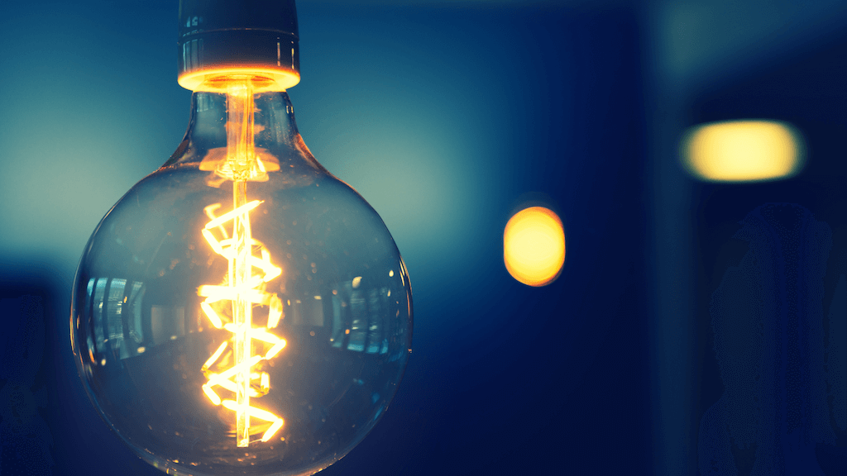
ENERGY CONSUMPTION

Slide 3
Introduction:-
Understanding sustainability and responsible for resource management are paramount, optimizing our energy consumption is of utmost importance. The 'Measured Energy Consumption Project' aims to address this critical need by developing a comprehensive system for accurately measuring, monitoring, and analyzing energy usage in various settings. This project is designed to empower individuals, businesses, and communities with the knowledge and tools to make informed decisions about their energy consumption, ultimately contributing to a more energy-efficient and environmentally sustainable future."

Slide 4
INTERNET-CONNECTED APPLIANCES:-
Connecting and automating kitchen appliances can save time, money and energy. Today’s smart kitchen gadgets connect to your home automation system for convenience and savings. You can command your coffee maker to be ready with a hot beverage when you wake up. Preheat your oven on the way home from work so it’s ready for making dinner. Optimize your refrigerator and freezer temperatures to minimize energy use.
Generally, smart home devices that are worth in the kitchen, by using these techniques we can implement for all the home appliances to obtain proper output with less errors.

Slide 5
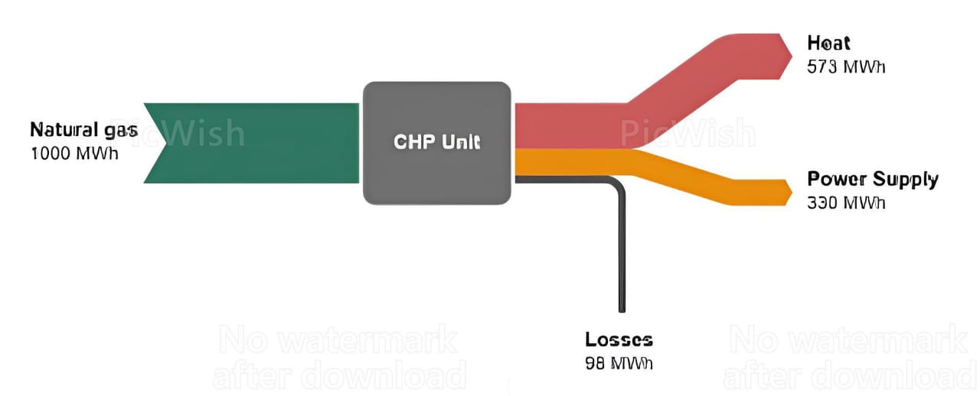
OBJECTIVE:-
In order to promote sustainable economic development and environmental protection, energy efficiency has been widely acknowledged as a top priority for international organizations, governments, firms, and even households across the world
Select Measurement Tools: Choose the appropriate instruments or sensors for your specific application. This might include smart meters, energy monitors, data loggers, or even software solutions.
Data Collection: Collect energy consumption data over a defined period. Ensure that the data is accurate and comprehensive, covering all relevant sources of energy use.
Data Analysis: Analyze the collected data to identify trends energy consumption.

Slide 6
Data collection and preprocessing:-
Data collection can be done by initializing the sensor in the buildings and in industries . This follows certain steps ..
Define objectives: Determine what you want to monitor and achieve in the building.
Choose sensors: Select the appropriate sensor types for your goals.
Place sensors strategically: Position sensors in optimal locations within the building.
Ensure power and connectivity: Provide sensors with power sources and connectivity for data transmission.
Implement an IoT platform: Set up a system to manage, store, and analyze sensor data.
Prioritize security and privacy: Protect sensor data from unauthorized access and address privacy concerns.
Calibrate and maintain sensors: Regularly calibrate and maintain sensors to ensure accuracy.

Slide 7
TECHNIQUE:-
Energy-efficient appliances: Upgrade to energy-efficient appliances and lighting, such as LED bulbs and Energy Star-rated devices.
Insulation: Improve insulation in your home to reduce heating and cooling energy needs.
Energy-efficient lighting: Install sensors and timers for lighting control in commercial and residential buildings.
Waste heat recovery: Capture and reuse waste heat generated in industrial processes.

Slide 8
Design thinking for measured energy consumption :-
Empathize:
Understand the needs and behaviors of users in relation to energy consumption . Gather data on current energy usage patterns and pain points.
Define:
Clearly define the problem or opportunity related to measured energy consumption. Create user needs to represent different energy user types.
Ideate:
Brainstorm creative ideas and solutions to address energy efficiency. Encourage cross-disciplinary collaboration to generate diverse concept.

Slide 9
Test:
Collect feedback from users on the prototypes' effectiveness and user-friendliness .
Implement:
Develop a final solution that integrates the insights and improvements identified during testing . Ensure the solution is user-friendly, accessible, and compatible with different energy monitoring systems.
Measure:
Continuously monitor the energy consumption data and user behavior with the implemented solution . Use data analytics to assess the impact of the solution on energy efficiency.
Iterate:
Based on the measured results, make ongoing refinements to the solution to enhance energy conservation and user satisfaction . Throughout this process, design thinking encourages collaboration, empathy for users, and a focus on iterative improvement to develop effective solutions for measured energy consumption.

Slide 10
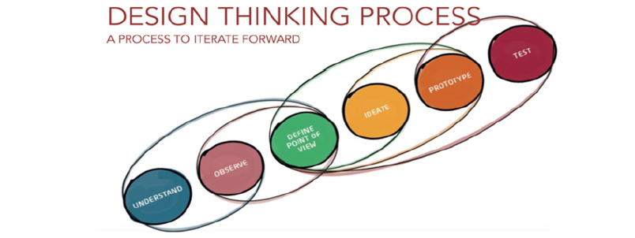
DESIGN THINKING
The main aim of the study was to identify safe and reliable energy solutions for people living in rural communities . The scope of the research is to promote energy solutions .
This phase is to analyze the data and store in a certain cloud and use for analyzing
the energy in future purpose when the user is not around. This undergoes several
testing process

Slide 11
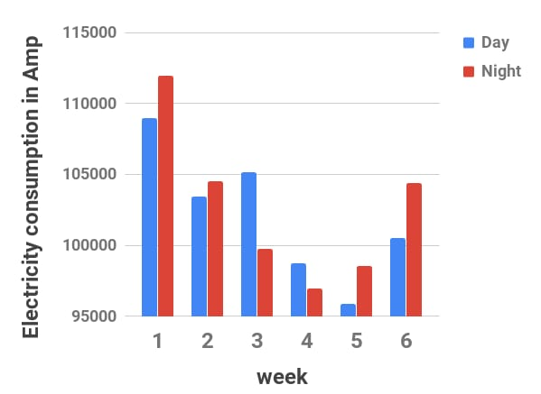
The overall analysis of the electricity consumption is mainly occurs during night time which can be reduced.
This technique is introduced to reduce consumption of energy by analysing the unused electrical appliances and switch them off when not required which is done automatically by using this program with multiple sensors to detect them.

Slide 12
ALGORITHM: Steps:-
1.if motion sensed by the PIR sensor
then
2. Turned ON Light
3. Else
4. Keep sensing
5. end if
6. if MQ5 gas value greater than or
equals to 1050 then
7. Start Alarm
8. else
9. Keep sensing
10. end if
11. if electromagnetic door sensor
lost the line of sight connection for
30 sec then

Slide 13
12. Start Alarm
13. else
14. Keep checking
15. end if
16. if temperature less than or
equals to 24°C then
17. Turned OFF Fan
18. else
19. if temperature greater
than 24°C then
Turned ON Fan
(Speed of Fan increased with the
increase in temperature)
20. end if
21. end if

Slide 14
This algorithm is written on Arduino for the smart home system. In smart home system, the Passive Infrared Sensor motion sensor is installed on the top of door to monitor the motion when a person enter into the room. When a person enters into the room the sensor detects motion
as a result the lights turned ON.
A gas sensor is installed in a kitchen for the safety purpose to handle the critical situation.
The MQ5 sensor sense the data, if its values is greater than a
predefined threshold as a result alarm is turned ON to
notify the user that there is leakage or high amount of gas is detected in
the kitchen.
The working of fan which is based on room temperature. If the temperature detected less or equal to 24°C then the Fan is kept OFF, on the other hand, if the temperature exceeds from 24 °C the Fan is turned ON . Therefore, with the increase of temperature the speed of Fan also increased.
In similar way all home appliances can be controlled by placing appropriate sensors.

Slide 15
Hardware setup:
Raspberry Pi (with Raspbian OS)
Relay module Light or
any electrical appliance
Jumper wires
Wiring:
Connect one side of the relay to a GPIO pin (e.g., GPIO17) on the Raspberry Pi.
Connect the other side of the relay to the electrical appliance.
Ensure proper grounding and power connections

Slide 16
PROGRAM:
import RPi.GPIO as GPIO
import time
# Set the GPIO mode to BCM
GPIO.setmode(GPIO.BCM)
# Define the GPIO pin connected to the relay
relay_pin = 17
# Initialize the GPIO pin as an output
GPIO.setup(relay_pin, GPIO.OUT)
try:
while True:
# Turn the relay ON (appliance OFF) GPIO.output(relay_pin, GPIO.HIGH)
print("Light OFF")
time.sleep(5)
# You can adjust the delay
# Turn the relay OFF (appliance ON) GPIO.output(relay_pin, GPIO.LOW)
print("Light ON")
time.sleep(5)
except KeyboardInterrupt:
print("Ctrl+C pressed. Exiting...")
finally:
GPIO.cleanup()

Slide 17
Explanation:
We import the necessary libraries, RPi.GPIO for controlling GPIO pins and time for adding delays .
We set the GPIO mode to BCM, which is a common pin numbering scheme . Define the GPIO pin (relay pin) to which the relay is connected .
Initialize the GPIO pin as an output . In a loop, the code alternately turns the relay ON and OFF with a delay, simulating turning the light ON and OFF .
The try-except block handles Keyboard Interrupt (Ctrl+C) to gracefully exit the program and clean up GPIO resources.

Slide 18
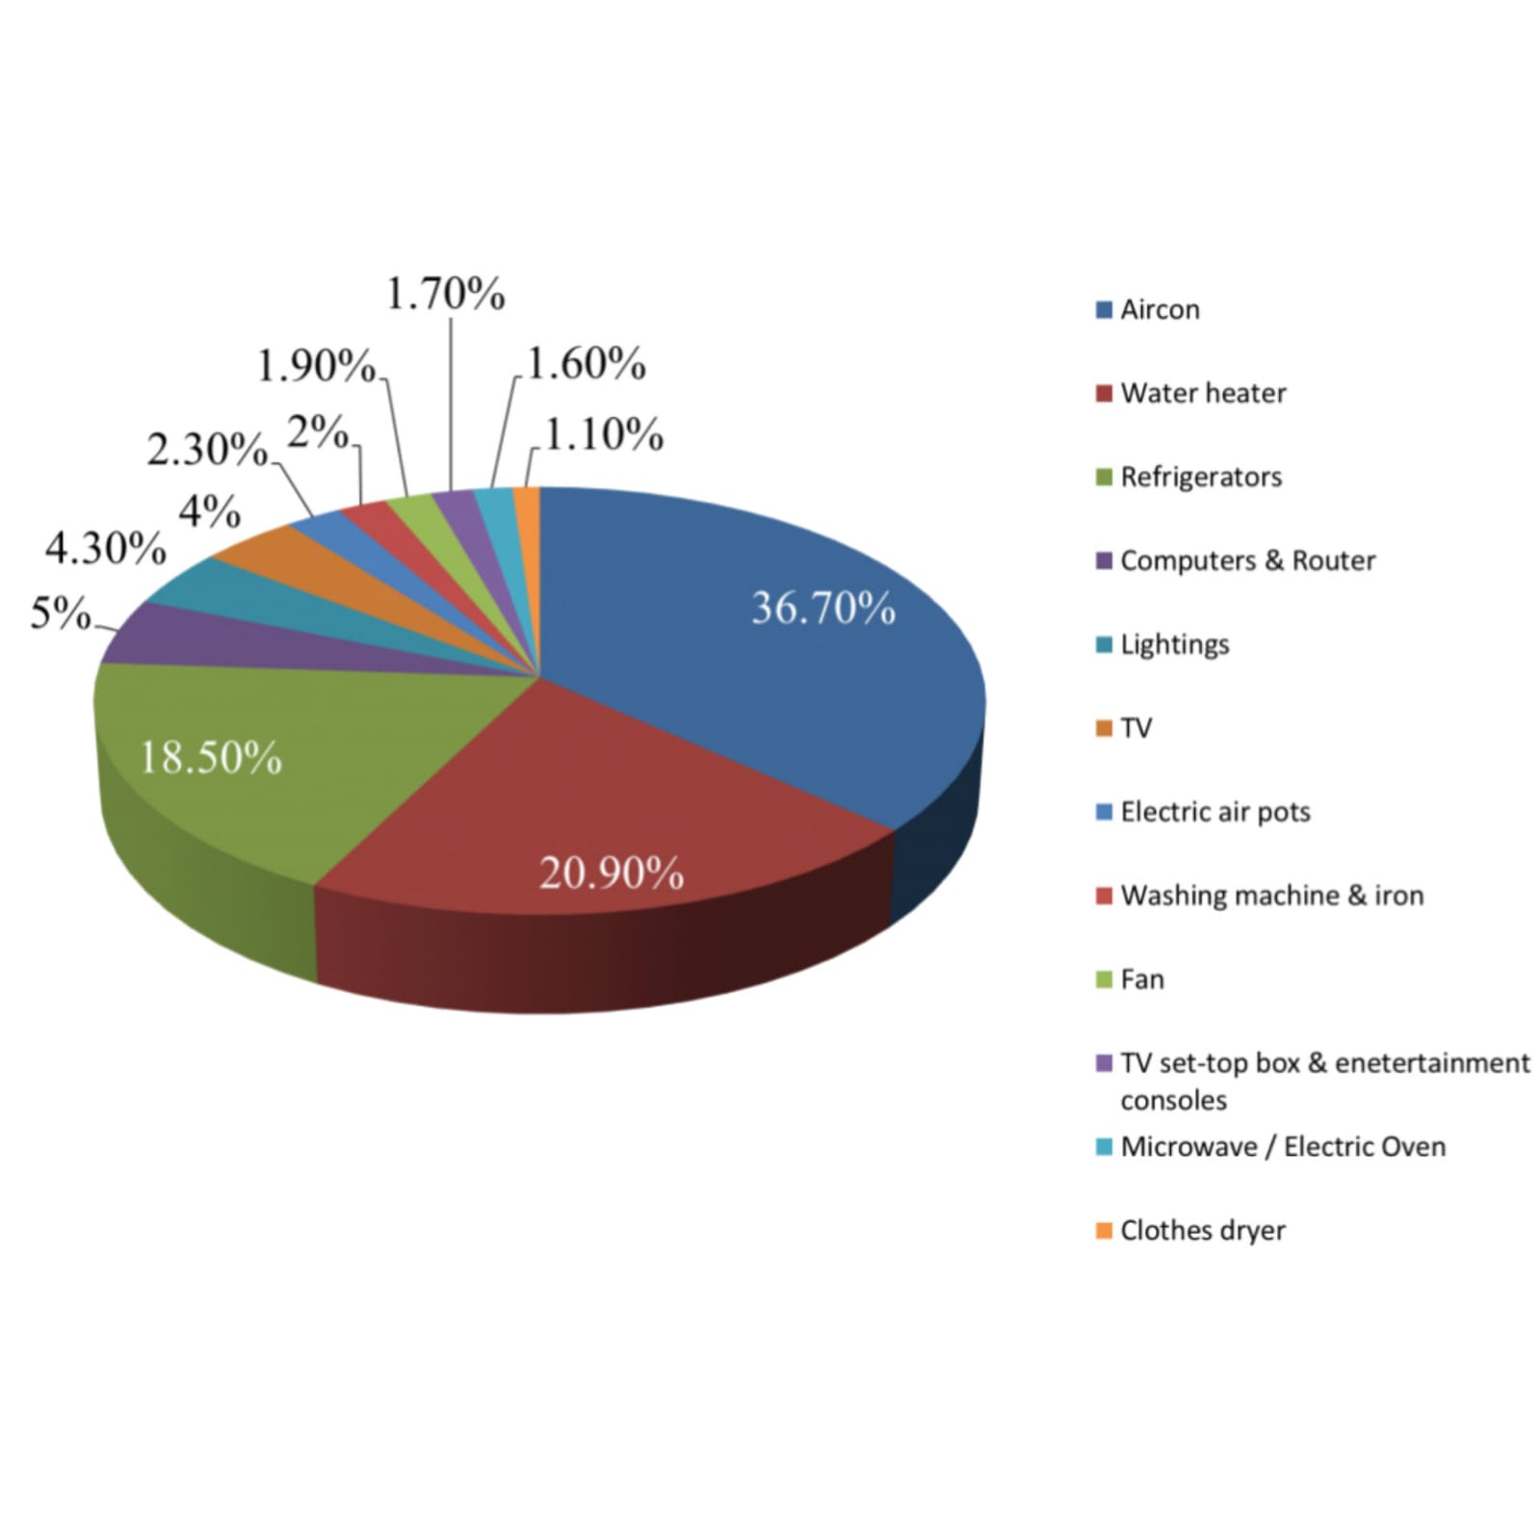
VISUALIZATION:
Pie charts will be useful in comparing the energy consumption of different locations, where the sum of each part will equal to a whole.
They are easy to read and with a quick scan of the chart, you can understand which site energy is consumed more and can reduce for future use. It is also good practice to include percentage labels which can be implement by using pie chart.

Slide 19
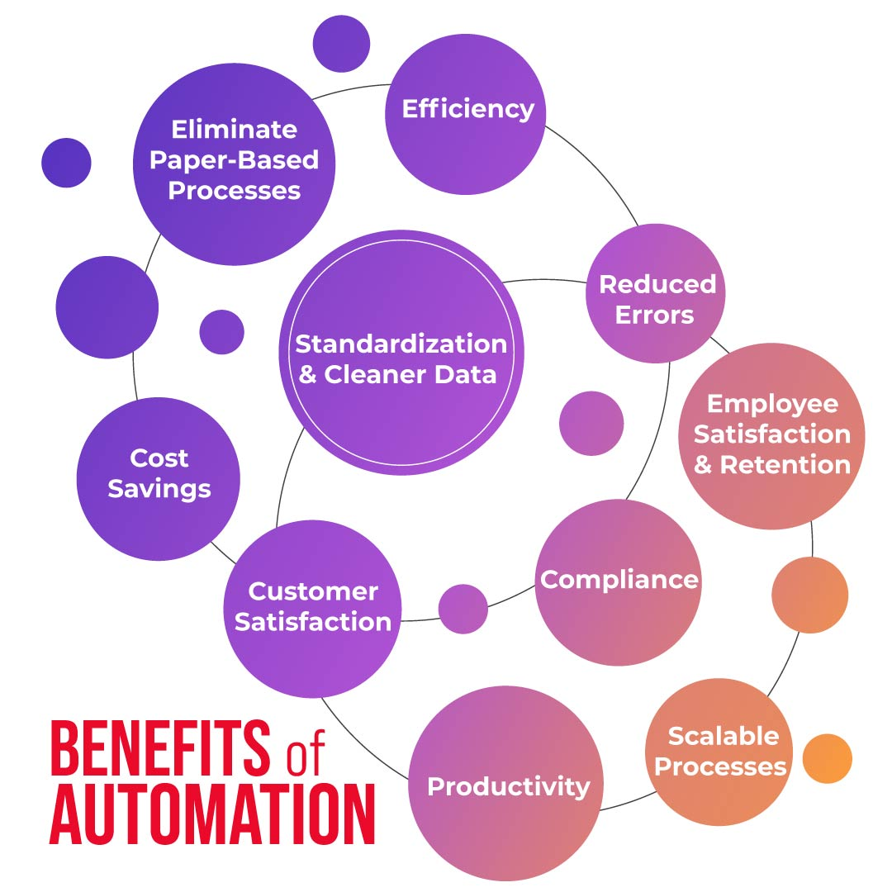
ENERGY AUTOMATION:-
Energy Automation is the convergence of home automation by using the internet connected appliances for energy storage, breakers and solar technologies all working seamlessly together. Managing energy use and production along with lighting, climate, shades and other home systems is the ultimate smart home!
The benefits of this innovation includes improved accuracy, reliability, and productivity, as well as improved employee morals.

Slide 20
CHALLENGES:-
The measurement of energy consumption is critical in understanding and optimizing energy usage in various sectors, including manufacturing sites, homes, commercial buildings, and transportation.
However, the manual collection and analysis of energy consumption data can be time-consuming and error.
SOLUTION:-
There is a need for an automated approach to collect, analyze and visualize energy consumption data for better decision-making.
So internet-connected appliances is based on less errors and to reduce time consumption which handles through mobile

Slide 21
CONCLUSION:-
In conclusion, energy consumption is a critical global issue with far-reaching environmental, economic, and social implications.
To mitigate its adverse effects, it is essential to embrace energy-efficient technologies.
Government policies, public awareness, and individual actions play pivotal roles in reducing energy consumption and ensuring with less errors and time saving probabilities.

